Slide 1



Exhaustive Analysis of the Indian Agriculture Sector Using Power BI By Momin Amaan

Slide 2

Learning Objectives
Understand agricultural trends: See how crop production changes over different years, states, and districts.
Analyze key insights: Find the top crops, best-performing states, and areas that need improvement.
Use Power BI for better decisions: Create interactive visuals to explore data easily and make smarter choices.
GOAL
Source :
www.freepik.com/

Slide 3
Tools and Technology used
Power BI – For data visualization, interactive dashboards, and insights.
Microsoft Excel – For data cleaning, preprocessing, and organization.
Power Query – For transforming and shaping data before visualization

Slide 4
Methodology
Data Collection: Used State-wise, District-wise, Season-wise, and Year-wise agricultural data.
The dataset includes information on crops, production, area, and yield.
Data Preprocessing:Cleaned and formatted raw data for consistency.
Managed missing values to ensure accurate visualizations.
Dashboard Creation in Power BI: Added interactive filters for State, District, Season, and Year
selection Implemented KPIs like Total Production, Crop Count, and Average Production.
created charts and graphs (bar charts, line graphs, pie charts) for trend analysis.
Insights & Analysis:
Identified top-performing and low-performing crops, states, and districts.
Analyzed yearly production trends to detect patterns and changes over time.

Slide 5
Problem Statement:
The project aims to conduct a comprehensive analysis of the Indian agriculture sector utilizing Power BI, a powerful business analytics tool.
This project, part of my Edunet Foundation internship, aims to analyzed Indian agriculture using State wise, district wise, Season wise and year-wise data. The dataset offers insights into various crops, their areas, production, and yields across States,districts and years. Using Power BI.
I aim to create interactive visualizations that reveal trends, patterns, and disparities, empowering stakeholders to make informed decisions for sustainable farming and resource allocation.

Slide 6
Solution:
Developed a Power BI Dashboard for interactive analysis of agricultural production.
Key Components of the Dashboard:
Filters for State, Season, and Crop – Allows dynamic data exploration.
KPIs (Key Metrics Display): Total Production, Crop Count, Average Production, etc.
Top 5 Crops by Production: Highlights the most cultivated crops.
Top & Bottom Performing Districts: Helps identify strong and weak regions.
Production Trends Over the Years: Line chart for analyzing growth patterns.
Production by Season: Understanding seasonal impact on crop yield.

Slide 7
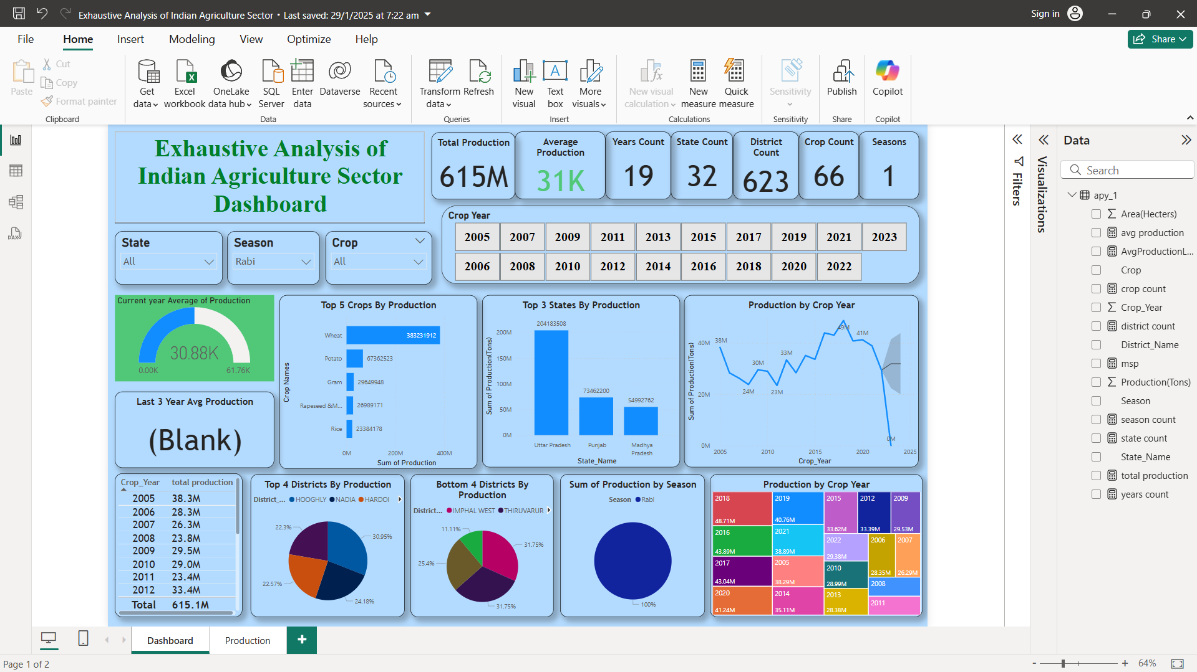
Screenshot of Output:

Slide 8
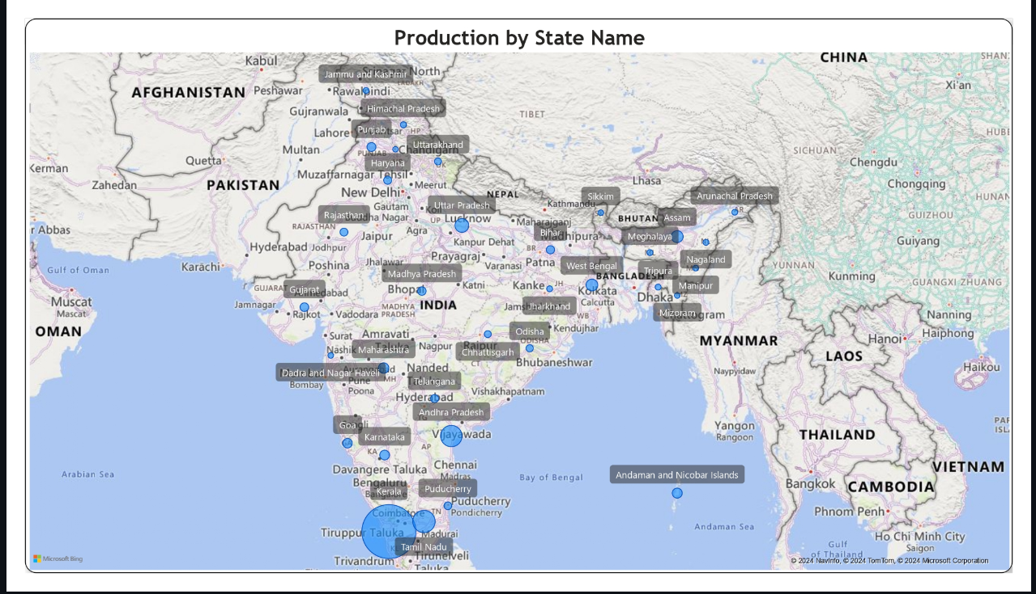

Slide 9
Conclusion:
The dashboard provides a clear understanding of Indian agricultural trends.
Users can analyze state-wise, district-wise, and crop-wise production easily.
The interactive nature of Power BI allows for real-time data filtering and deep insights.
This project helps policymakers, farmers, and researchers make informed decisions to
improve crop production and efficiency.
Future improvements could include weather data integration, predictive analytics,
and real-time data updates.

